Slide 1
The man with no bed.
by Terrence Pietrondi.

Slide 2
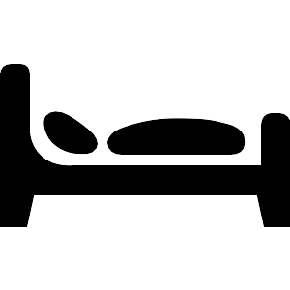
There is a man that has a bed…
but he doesn’t sleep there.

Slide 3
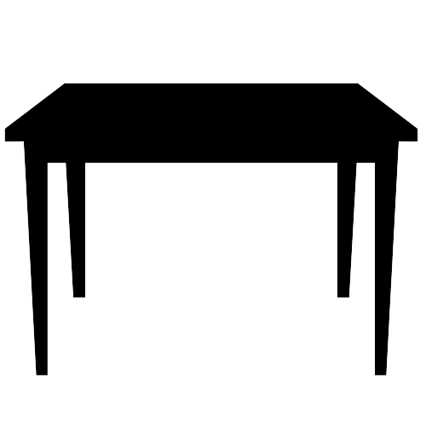
He sleeps at the kitchen table.

Slide 4

He sleeps in the chair.

Slide 5

And in the car.

Slide 6

Even during dinner!

Slide 7

While sitting behind the desk at work, he is suppose to greet customers…
but instead of saying “hello”,
he sleeps.

Slide 8

At his house, where the washing machine is…
he sleeps there too.

Slide 9
Since this man sleeps everywhere except his bed,
he is the man with no bed.
This man is my dad.
Goodnight dad.

Slide 10
Attribution
Sites
The Png Project - https://chrome.google.com/webstore/detail/mcioajokdgfncdnnhajlofmphdobjhla
The Noun Project - http://thenounproject.com/
Images
“Bed” symbol by Christopher T. Howlett, from The Noun Project
http://thenounproject.com/noun/bed/#icon-No1072
“Table” symbol by Sofie Hauge Katan, from The Noun Project
http://thenounproject.com/noun/table/#icon-No1392
“Chair” symbol by Sofie Hauge Katan, from The Noun Project
http://thenounproject.com/noun/chair/#icon-No1393
“Place Setting” symbol by Scott Lewis, from The Noun Project
http://thenounproject.com/noun/place-setting/#icon-No982
“Washing Machine” symbol by National Park Service
http://thenounproject.com/noun/washing-machine/#icon-No118
“Main Office” designed by Edward Boatman, Mike Clare, Jessica Durkin
http://thenounproject.com/noun/main-office/#icon-No737

Slide 11
License
This work is licensed under the Creative Commons Attribution-NonCommercial-NoDerivs 3.0 United States License.
To view a copy of this license, visit http://creativecommons.org/licenses/by-nc-nd/3.0/us/ or send a letter to Creative Commons, 444 Castro Street, Suite 900, Mountain View, California, 94041, USA.

